Slide 1
Basic concepts of RNA-seq data analysis
FILIP HORVAT Medils, 31. 8. 2022.

Slide 2

RNA-seq
RNA-seq is qualitative and quantitative description of RNA molecules in biological sample(s) or system(s)

Slide 3
What can we study with RNA-seq?
Splice isoforms
Novel transcripts
Allele-specific expression
Protein-RNA interactions
Non-coding transcripts (rRNA, tRNA, snRNA, snoRNA, miRNA, piRNA, exRNA, lncRNA…)
Post transcriptional modifications
Gene fusions
Differential expression of genes

Slide 4
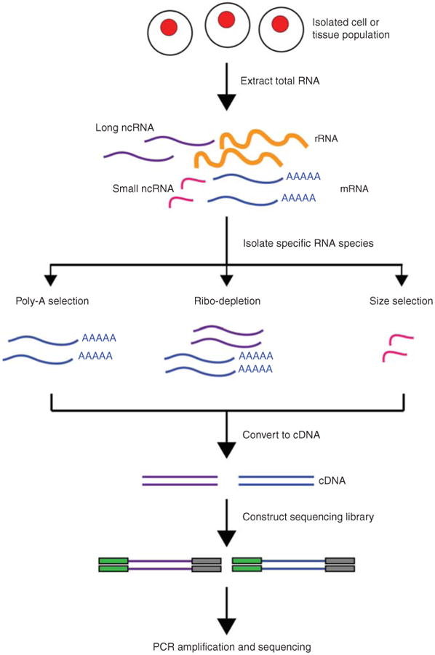
How RNA-seq (generally) works?

Slide 5
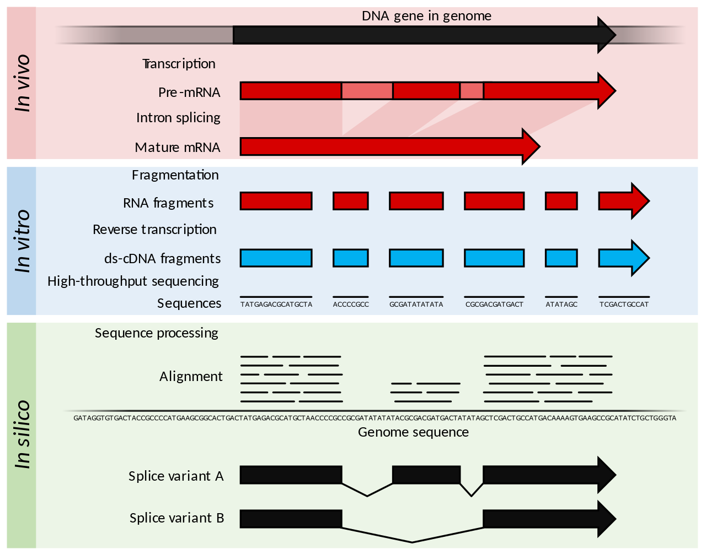
How RNA-seq (generally) works?
Adjusted from Wikipedia

Slide 6
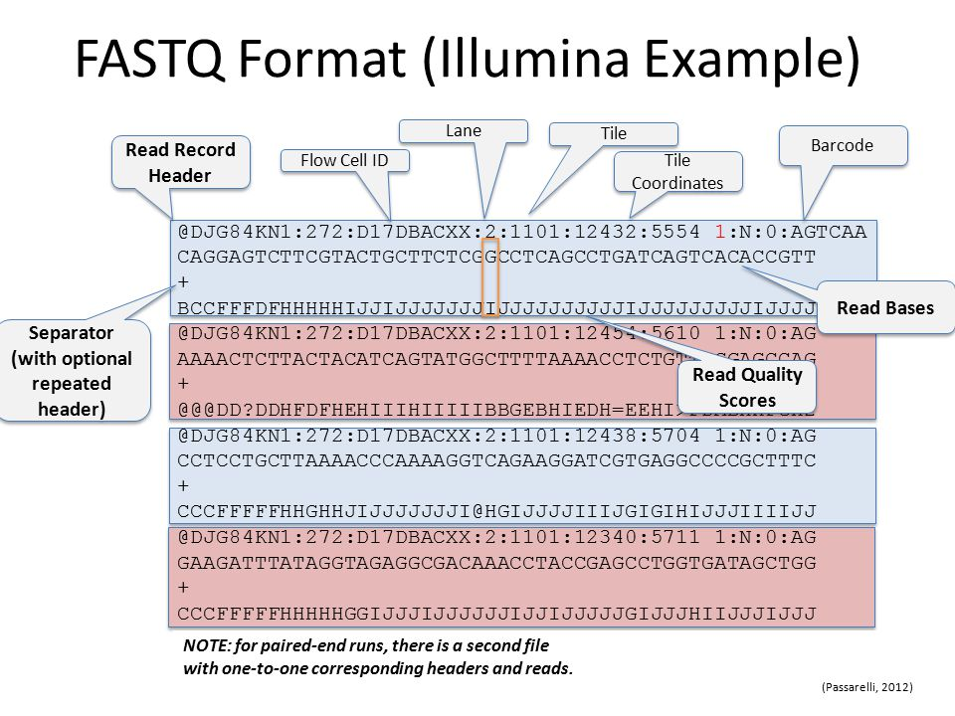
.fastq file details
1 read = 4 lines
Line 1 = read name, a sequence identifier with info about the sequencing run and cluster
Line 2 = the sequence itself, base calls (A, T, C, G or N)
Line 3 = just a separator, useless
Line 4 = quality scores from base caller, in Phred +33 encoding (more about it here: https://en.wikipedia.org/wiki/FASTQ_format#Quality)

Slide 7
Now the fun begins...
reference genome (.fasta)
alignment and mapping in a splice-aware manner (STAR)
baseline expression (TPM, FPKM)
gene expression quantification i.e. counting reads over genomic features (featureCounts)
quality control (FastQC) and
trimming (Cutadapt or Trimmomatic)
table with counts
.fastq files
.bam files
differential expression (R and DESeq2 library)
gene models (.gtf/.gff)
low-quality reads
reads with unknown bases (N)
contamination (bacterial, fungal, other microbes)
reads which are too short after trimming
https://training.galaxyproject.org/training-material/topics/transcriptomics/tutorials/ref-based/tutorial.html

Slide 8
.bam file details
binary version of a SAM file (Sequence Alignment Map)
tab-delimited text file that contains sequence alignment data
1 alignment = 1 line
very detailed description and specifications: http://samtools.github.io/hts-specs/SAMv1.pdf and https://github.com/samtools/hts-specs/blob/master/SAMtags.pdf

Slide 9
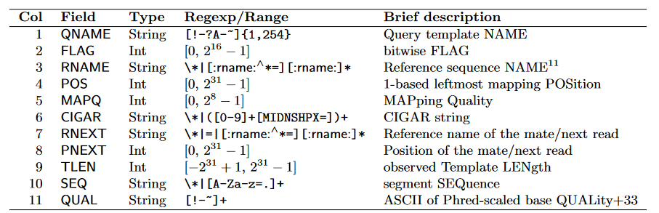
.bam file details
RNAME
CIGAR
PNEXT
SEQ
QNAME
FLAG
POS
MAPQ
RNEXT
TLEN
TAGS
QUAL

Slide 10
.bam file details
.fastq file
map to the genome
.bam file

Slide 11
Gene expression quantification
counting reads over features
 | Gene 1 | Gene 2
Counts | 19 | 23
reads
gene 1
gene 2
reference
genome

Slide 12
Gene expression quantification
read
read
read
gene A
gene A
gene A
gene A
read
read
read
read
gene A
gene A
gene A
gene A
gene B
gene B
read
gene A
read
read
. . .
gene B
gene A
pseudogene A

Slide 13
Gene expression quantification
gene_id | s_Ago2_WT_r2 | s_Ago2_CI_r1 | s_Ago2_CI_r2 | s_Ago2_KO_r1 | s_Ago2_KO_r2 | s_Ago2_WT_r1 | s_Ago2_WT_r3 | s_Dicer_KO_r1
ENSMUSG00000051951 | 100 | 164 | 197 | 161 | 127 | 58 | 49 | 99
ENSMUSG00000025900 | 109 | 288 | 311 | 301 | 287 | 117 | 116 | 223
ENSMUSG00000025902 | 5 | 1 | 2 | 0 | 6 | 0 | 1 | 0
ENSMUSG00000033845 | 770.89 | 677 | 649.74 | 693.5 | 699.8 | 580.96 | 718.64 | 170.58
ENSMUSG00000025903 | 2509.05 | 4046.57 | 4329.34 | 4632.67 | 4478.44 | 2102.75 | 2572.69 | 2422.59
ENSMUSG00000104217 | 595.75 | 788.5 | 884.33 | 812.33 | 773.25 | 519.83 | 549.33 | 751.83
ENSMUSG00000033813 | 7909.35 | 10735.91 | 10974.5 | 11218.52 | 10913.9 | 6674.47 | 7791.17 | 7684.18
ENSMUSG00000002459 | 10 | 19 | 22 | 11.2 | 37.07 | 9 | 5 | 21
ENSMUSG00000033793 | 3005.81 | 2949.35 | 2927.27 | 3041.27 | 3401.55 | 2578.18 | 3461.09 | 1020.56
ENSMUSG00000025905 | 33 | 86 | 76 | 76.03 | 38 | 35 | 55 | 47
ENSMUSG00000033774 | 0.03 | 2 | 0 | 0 | 0 | 0 | 0 | 0
ENSMUSG00000025907 | 11404.27 | 9428.18 | 8906.9 | 8992.04 | 8813.3 | 10098.67 | 10430.49 | 8857.89
ENSMUSG00000087247 | 0.5 | 2 | 1 | 2 | 2 | 0.5 | 1 | 2.5
ENSMUSG00000033740 | 406 | 665.14 | 655 | 692 | 676 | 293 | 348 | 594.33
ENSMUSG00000051285 | 983.83 | 903.92 | 814.58 | 969.75 | 979.67 | 909.17 | 1052.97 | 713.75
ENSMUSG00000025909 | 32 | 546.87 | 543 | 560 | 530.27 | 31 | 21.1 | 385.17
ENSMUSG00000061024 | 9.5 | 28.92 | 11.33 | 10.5 | 36 | 4.5 | 9 | 29
ENSMUSG00000025911 | 1768.5 | 3918 | 3913 | 4172 | 3577.5 | 1391.5 | 1411 | 3108.5
+ 6 samples
+ 21829
annotated
genes
Data from:
Stein P, Rozhkov NV, Li F, Cárdenas FL, Davydenko O, Vandivier LE, Gregory BD, Hannon GJ, Schultz RM. Essential Role for endogenous siRNAs during meiosis in mouse oocytes. PLoS Genet. 2015 Feb 19;11(2):e1005013. doi: 10.1371/journal.pgen.1005013. Erratum in: PLoS Genet. 2015 Apr;11(4):e1005129. PMID: 25695507; PMCID: PMC4335007.

Slide 14
Differential gene expression analysis
computational procedure where reads counts over some features (genes or transcripts) are normalized and statistically tested
goal is to find quantitative changes in expression levels between different experimental groups
done in R using libraries (EdgeR, DESeq2)

Slide 15
Examples
RNA-sequencing data of TIP60 mutated and control U2OS cells (Wichmann et al., 2022)
airway smooth muscle cells treated with dexamethasone (a synthetic glucocorticoid steroid with anti-inflammatory effects) vs. untreated cells (Himes et al., 2014)
CDK12 in A2780 cell line was stably knocked-out and RNA-seq profiling comparing WT and KO conditions was performed (Chilà et al., 2022)
study revealed CLCA1 to be a prognostic and diagnostic biomarker for colorectal cancer (Wei et al., 2020)
study investigated the regulation of gene expression occurring in rice roots at different stages of nodule-like structures formation: early (1-dpt) and late (14-dpt) (Thomas et al., 2020)
GV and MII oocytes in human women of different ages were sequenced and several hundred transcripts were found to be expressed at significantly different levels (Ntostis et al., 2021)
Wichmann J, Pitt C, Eccles S, Garnham AL, Li-Wai-Suen CSN, May R, Allan E, Wilcox S, Herold MJ, Smyth GK, Monahan BJ, Thomas T, Voss AK. Loss of TIP60 (KAT5) abolishes H2AZ lysine 7 acetylation and causes p53, INK4A, and ARF-independent cell cycle arrest. Cell Death Dis. 2022 Jul 20;13(7):627. doi: 10.1038/s41419-022-05055-6. PMID: 35853868; PMCID: PMC9296491.
Himes BE, Jiang X, Wagner P, Hu R, Wang Q, Klanderman B, Whitaker RM, Duan Q, Lasky-Su J, Nikolos C, Jester W, Johnson M, Panettieri RA Jr, Tantisira KG, Weiss ST, Lu Q. RNA-Seq transcriptome profiling identifies CRISPLD2 as a glucocorticoid responsive gene that modulates cytokine function in airway smooth muscle cells. PLoS One. 2014 Jun 13;9(6):e99625. doi: 10.1371/journal.pone.0099625. PMID: 24926665; PMCID: PMC4057123.
Chilà R, Chiappa M, Guffanti F, Panini N, Conconi D, Rinaldi A, Cascione L, Bertoni F, Fratelli M, Damia G. Stable CDK12 Knock-Out Ovarian Cancer Cells Do Not Show Increased Sensitivity to Cisplatin and PARP Inhibitor Treatment. Front Oncol. 2022 Jul 13;12:903536. doi: 10.3389/fonc.2022.903536. PMID: 35912188; PMCID: PMC9328802.
Wei FZ, Mei SW, Wang ZJ, Chen JN, Shen HY, Zhao FQ, Li J, Liu Z, Liu Q. Differential Expression Analysis Revealing CLCA1 to Be a Prognostic and Diagnostic Biomarker for Colorectal Cancer. Front Oncol. 2020 Oct 28;10:573295. doi: 10.3389/fonc.2020.573295. Erratum in: Front Oncol. 2020 Dec 18;10:634122. PMID: 33251137; PMCID: PMC7673386.
Thomas J, Hiltenbrand R, Bowman MJ, Kim HR, Winn ME, Mukherjee A. Time-course RNA-seq analysis provides an improved understanding of gene regulation during the formation of nodule-like structures in rice. Plant Mol Biol. 2020 May;103(1-2):113-128. doi: 10.1007/s11103-020-00978-0. Epub 2020 Feb 21. PMID: 32086696; PMCID: PMC7695038.
Ntostis P, Iles D, Kokkali G, Vaxevanoglou T, Kanavakis E, Pantou A, Huntriss J, Pantos K, Picton HM. The impact of maternal age on gene expression during the GV to MII transition in euploid human oocytes. Hum Reprod. 2021 Dec 27;37(1):80-92. doi: 10.1093/humrep/deab226. PMID: 34755188; PMCID: PMC8730309.

Slide 16
Practical part
1. Install libraries
2. Set paths, read data
3. Clean and prepare data for the procedure
4. Exploratory analysis of raw counts
5. Run the DESeq algorithm
6. Extract the results and save them as table
7. Visualize the results
8. Functional gene enrichment
9. Pathway analysis

Slide 17
1. Install libraries
Download the scripts and input data:
https://bit.ly/medils_RNAseq_practical
create a new folder where you will put all the scripts and the data
open script 00.install_libraries.R and run it (CTRL + SHIFT + ENTER)
backup:
https://github.com/fhorvat/MedILS_summer_school.2022
even more backup:
https://s3-elixir.cloud.e-infra.cz/fhorvat/public/other_data/00.install_libraries.R
https://s3-elixir.cloud.e-infra.cz/fhorvat/public/other_data/01.diff_exp_analysis.tidyverse.R
https://s3-elixir.cloud.e-infra.cz/fhorvat/public/other_data/Stein_2015_PLoSGenet_GSE57514.ensembl.93.GRCm38.p6.20180919.UCSCseqnames.counts.txt
https://s3-elixir.cloud.e-infra.cz/fhorvat/public/other_data/Stein_2015_PLoSGenet_GSE57514.sampleTable.csv

Slide 18
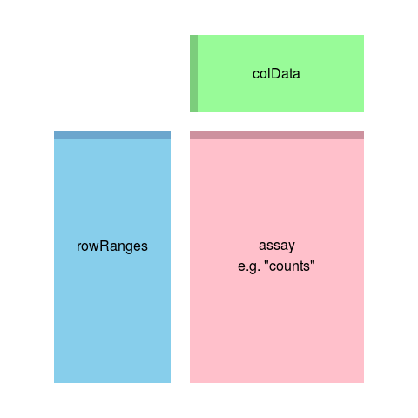
SummarizedExperiment object
assay - matrix of counts
head(assay(se))
rowRanges - information about the genomic ranges
rowRanges(se)
colData - information about the samples
colData(se)

Slide 19
DESeqDataSet object
object class used by the DESeq2 package to store the read counts and the intermediate data during statistical analysis
must have an associated design formula
describes experimental design, i. e. tells the DESeq which factors in your experiment influence counts
used to estimate the dispersions and to estimate the log2 fold changes of the model

Slide 20
Multi-factor design
in experiment, more than one factor can influence the counts
for example, airway data
DESeq2 can analyze any possible experimental design that can be expressed with fixed effects terms
more about interactions and design formulas: http://bioconductor.org/packages/devel/bioc/vignettes/DESeq2/inst/doc/DESeq2.html#interactions
library(airway)
data("airway")
colData(airway)
dds <- DESeqDataSet(airway, design = ~ cell + dex)

Slide 21
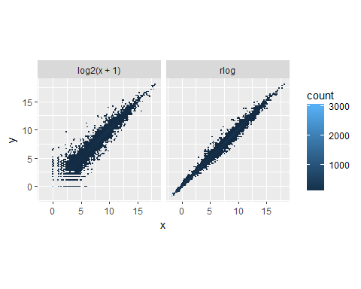
rlog transformation
regularized log transformation of the count data
transforms raw counts to log2 scale with special handling of rows with small counts
for genes with high counts, the rlog transformation will give similar result to the ordinary log2 transformation of normalized counts
for genes with lower counts the values are shrunken towards the genes’ averages across all samples
used for visualization, clustering or other machine learning tasks
why do we transform the counts to log scale?
to remove heteroskedasticity
in RNA-seq data, variance between gene counts in samples grows along with the mean
total variance is influenced mostly by a few most strongly expressed genes because they show the largest absolute differences between samples
log scale makes data more symmetrical, i.e. data changes proportionally and not additively
consider counts of 3 different genes = 0.1, 1 and 10
on the log2 scale, change of +1/-1 means doubling/halving of the underlying data

Slide 22
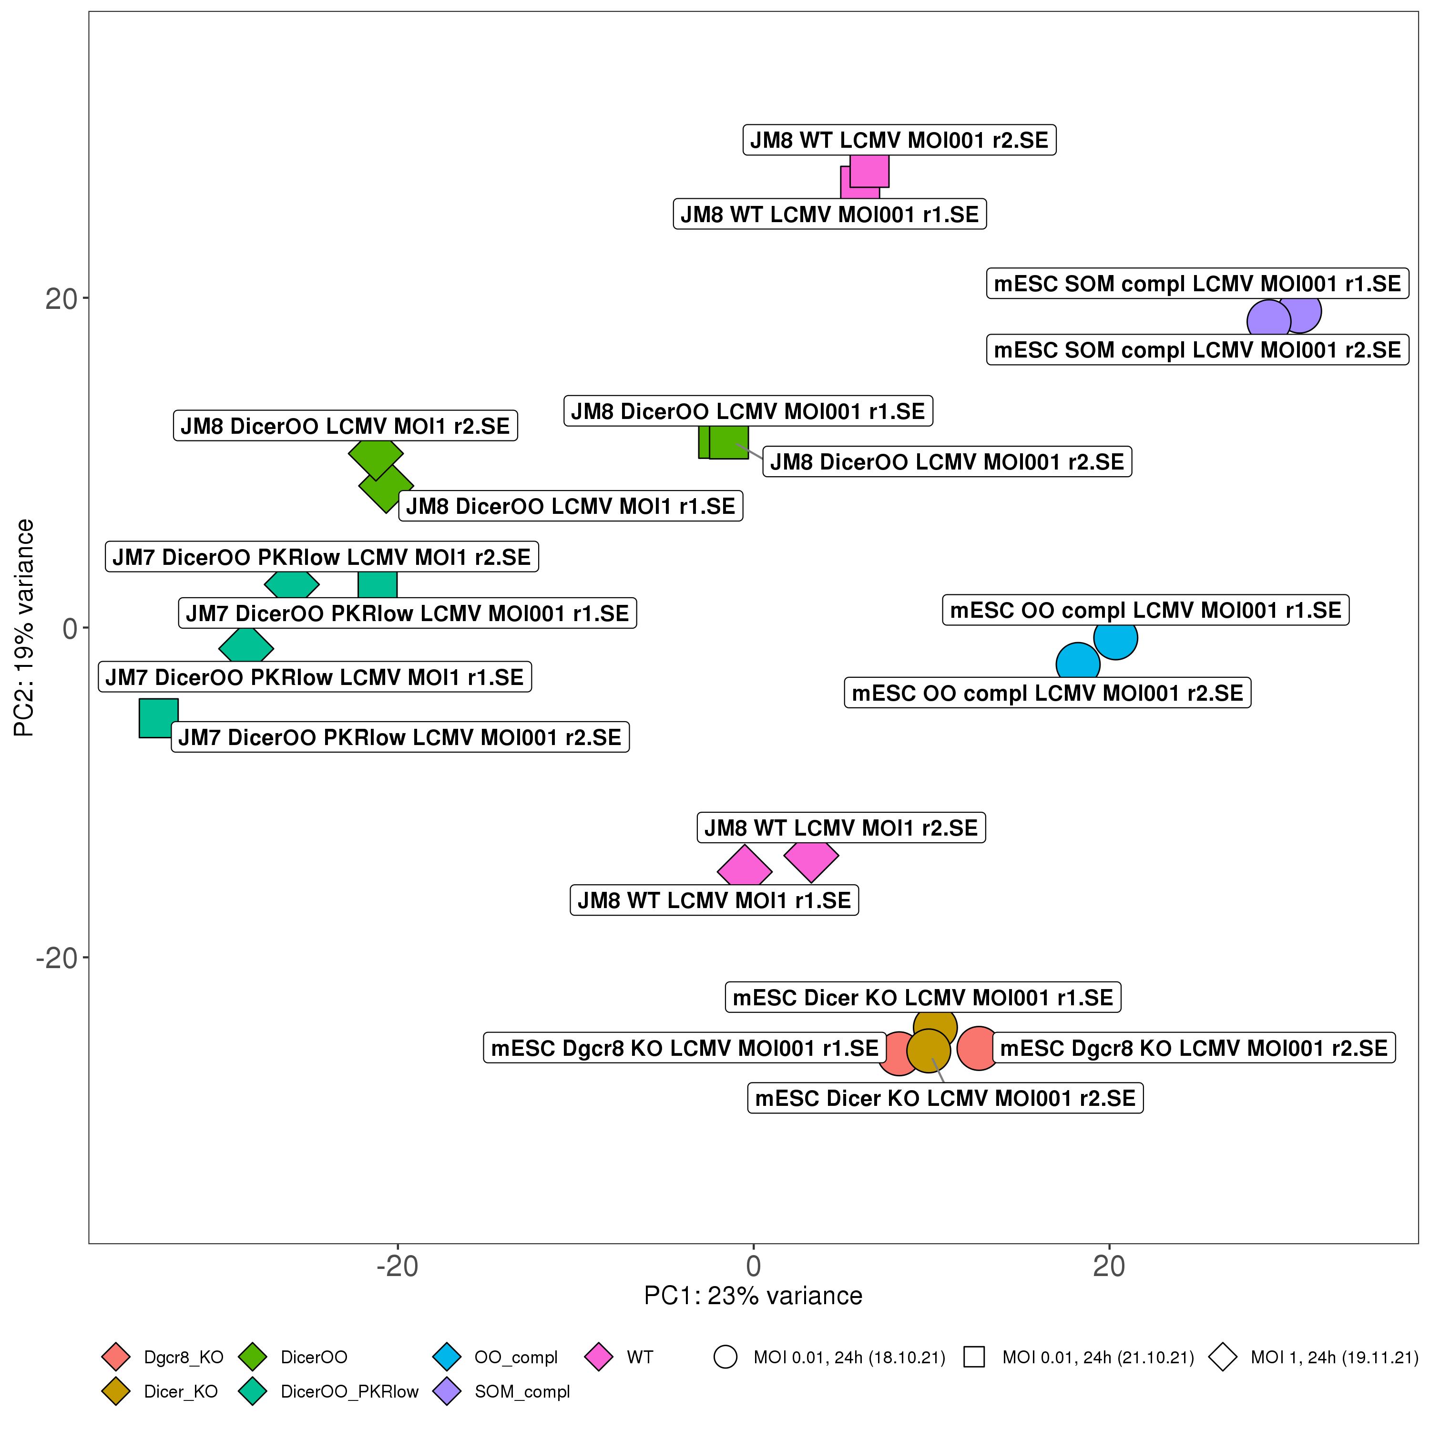
PCA
Principal Component Analysis
used for dimensionality reduction
takes complex, high-dimensional data and reduces it to much smaller dataset while losing as little information as possible

Slide 23
Example data
 | Mouse 1 | Mouse 2 | Mouse 3 | Mouse 4 | ...
Gene 1 | 3 | 0.25 | 2.8 | 0.1 | ...
Gene 2 | 2.9 | 0.8 | 2.2 | 1.8 | ...
Gene 3 | 2.2 | 1 | 1.5 | 3.2 | ...
Gene 4 | 2 | 1.4 | 2 | 0.3 | ...
Gene 5 | 1.3 | 1.6 | 1.6 | 0 | ...
Gene 6 | 1.5 | 2 | 2.1 | 3 | ...
Gene 7 | 1.1 | 2.2 | 1.2 | 2.8 | ...
Gene 8 | 1 | 2.7 | 0.9 | 0.3 | ...
Gene 9 | 0.9 | 2.6 | 0.8 | 0.4 | ...
Gene 10 | 0.4 | 3 | 0.6 | 0.1 | ...

Slide 24
Another example data
Pokemon | type 1 | type 2 | weight | height | base experience | attack | defense | special_attack | special_defense | speed | hp | egg group 1 | egg group 2
Bulbasaur | grass | poison | 69 | 7 | 64 | 49 | 49 | 65 | 65 | 45 | 45 | monster | plant
Ivysaur | grass | poison | 130 | 10 | 142 | 62 | 63 | 80 | 80 | 60 | 60 | monster | plant
Venusaur | grass | poison | 1000 | 20 | 236 | 82 | 83 | 100 | 100 | 80 | 80 | monster | plant
Charmander | fire | NA | 85 | 6 | 62 | 52 | 43 | 60 | 50 | 65 | 39 | monster | dragon
Charmeleon | fire | NA | 190 | 11 | 142 | 64 | 58 | 80 | 65 | 80 | 58 | monster | dragon
Charizard | fire | flying | 905 | 17 | 240 | 84 | 78 | 109 | 85 | 100 | 78 | monster | dragon
Squirtle | water | NA | 90 | 5 | 63 | 48 | 65 | 50 | 64 | 43 | 44 | monster | water1
Wartortle | water | NA | 225 | 10 | 142 | 63 | 80 | 65 | 80 | 58 | 59 | monster | water1
Blastoise | water | NA | 855 | 16 | 239 | 83 | 100 | 85 | 105 | 78 | 79 | monster | water1
... | ... | ... | ... | ... | ... | ... | ... | ... | ... | ... | ... | ... | ...

Slide 25
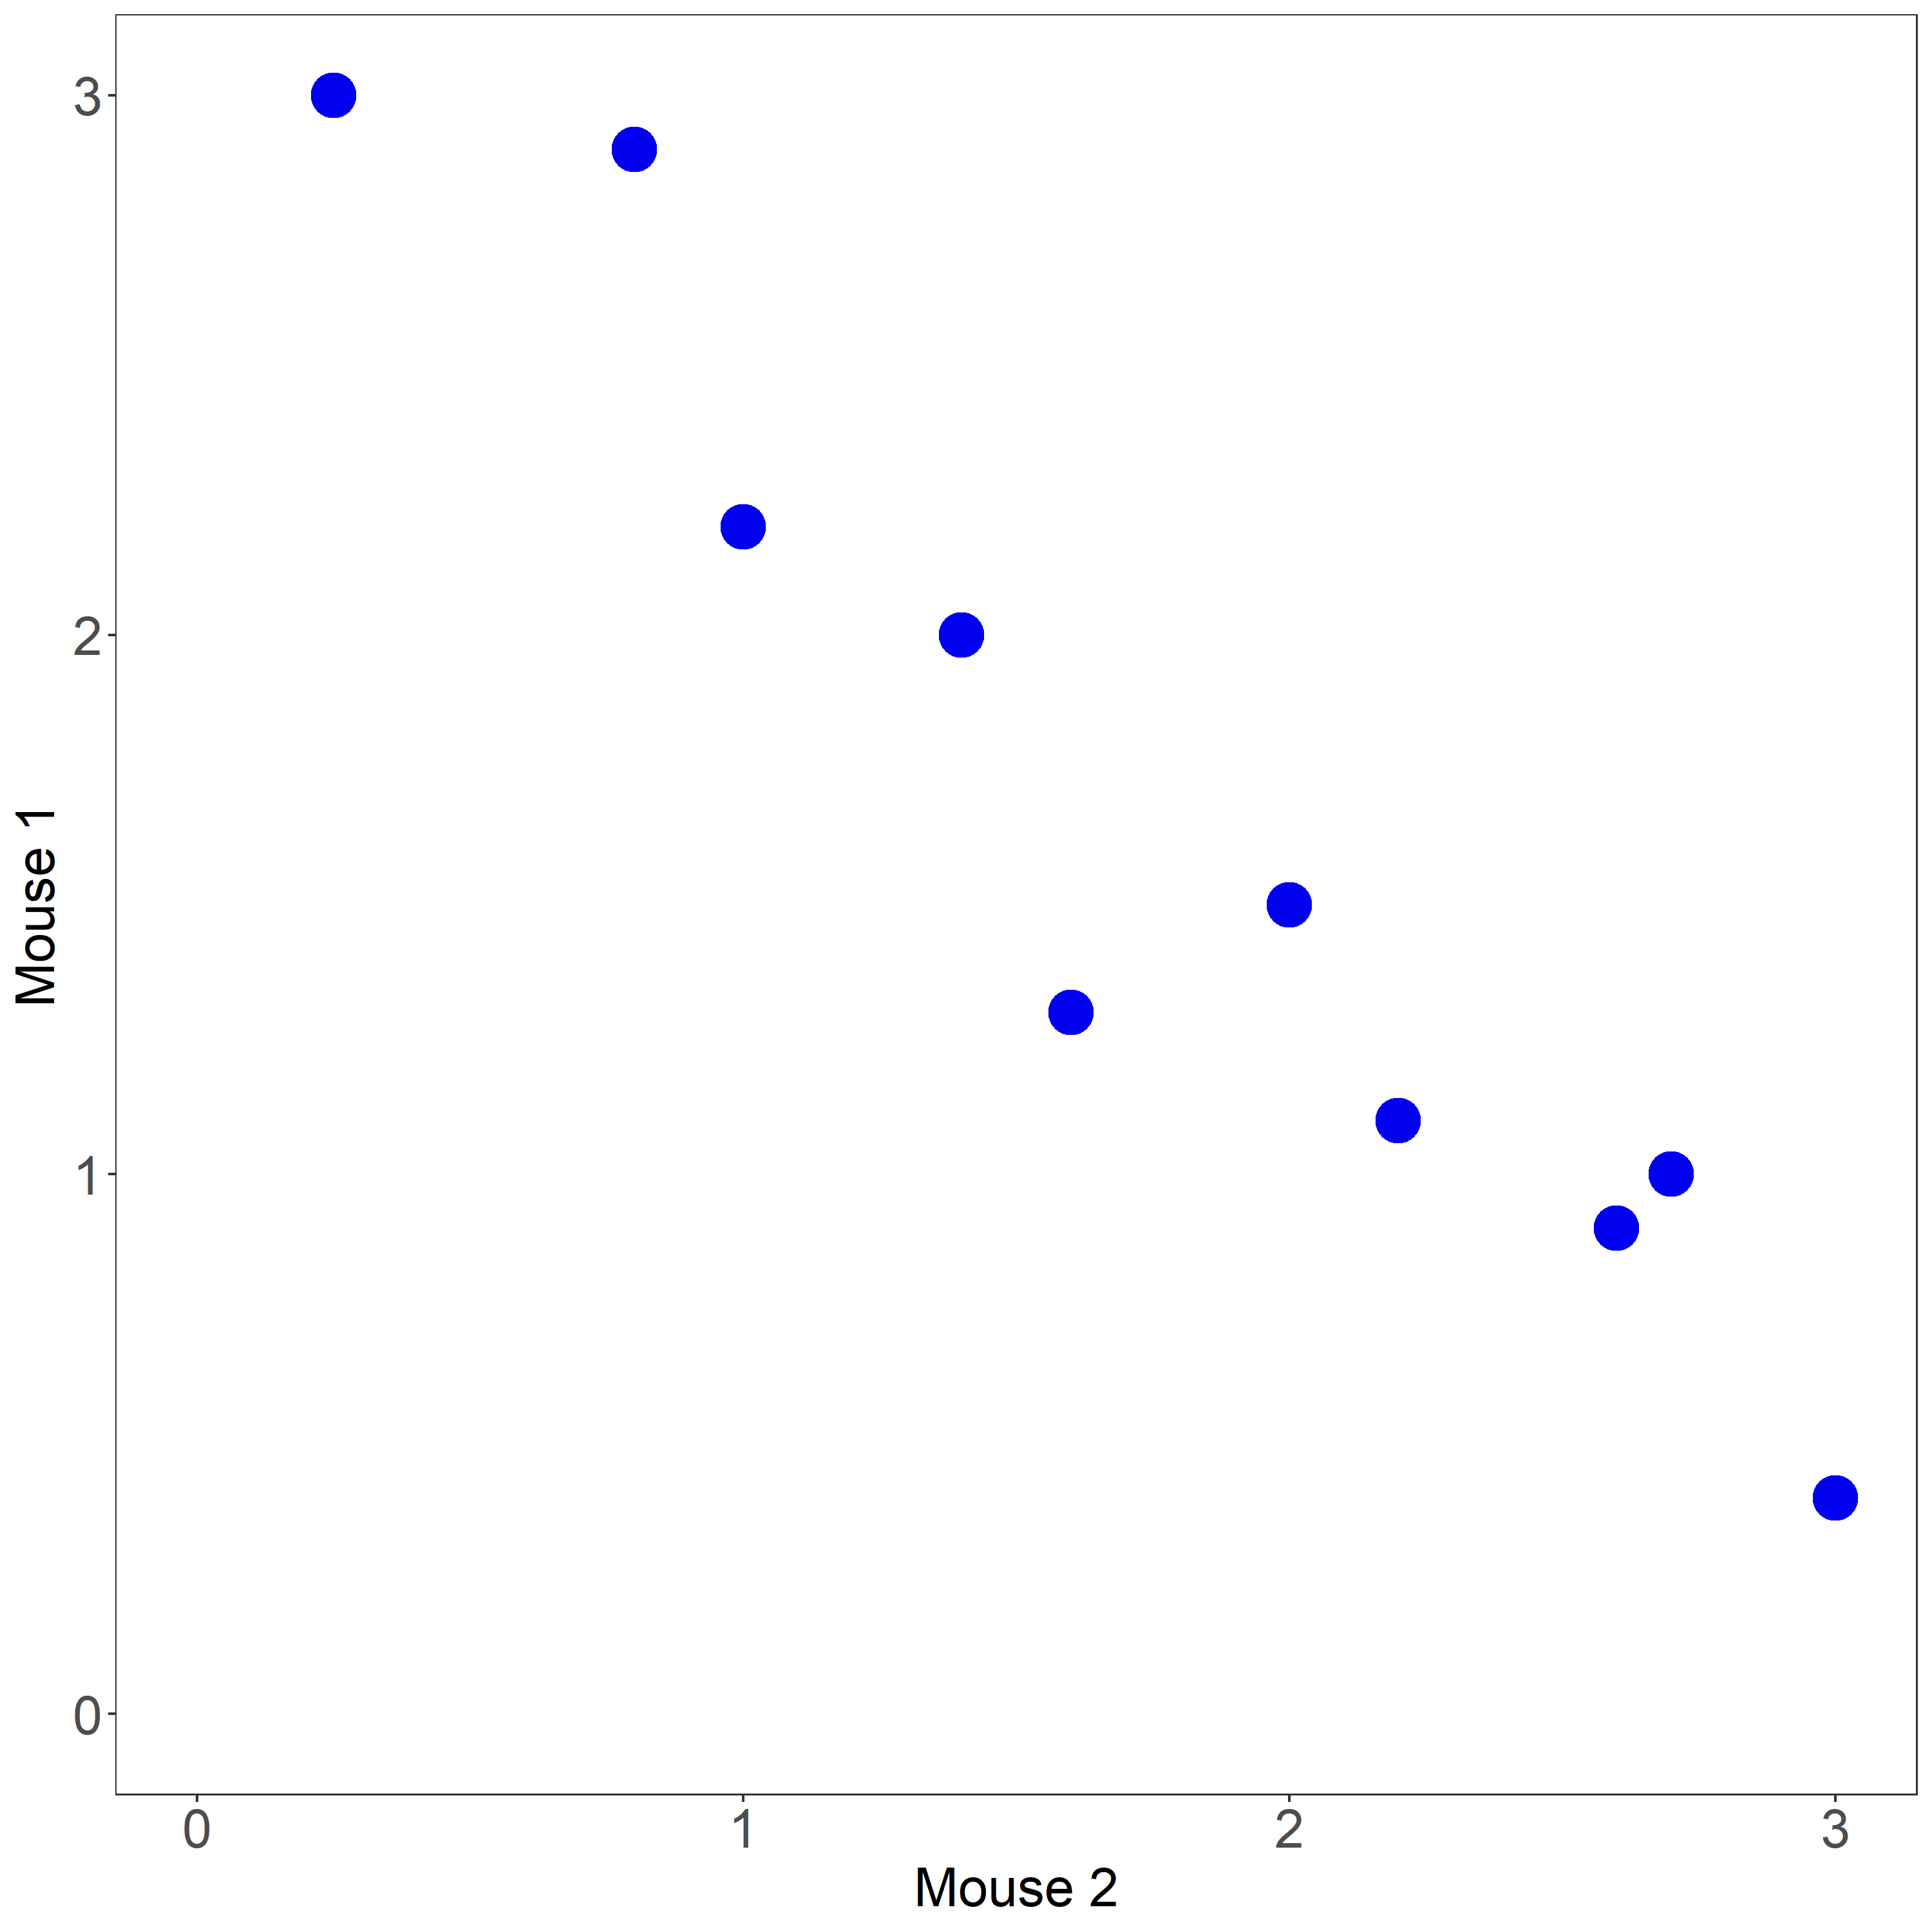
Example – 2D
 | Mouse 1 | Mouse 2
Gene 1 | 3 | 0.25
Gene 2 | 2.9 | 0.8
Gene 3 | 2.2 | 1
Gene 4 | 2 | 1.4
Gene 5 | 1.3 | 1.6
Gene 6 | 1.5 | 2
Gene 7 | 1.1 | 2.2
Gene 8 | 1 | 2.7
Gene 9 | 0.9 | 2.6
Gene 10 | 0.4 | 3

Slide 26
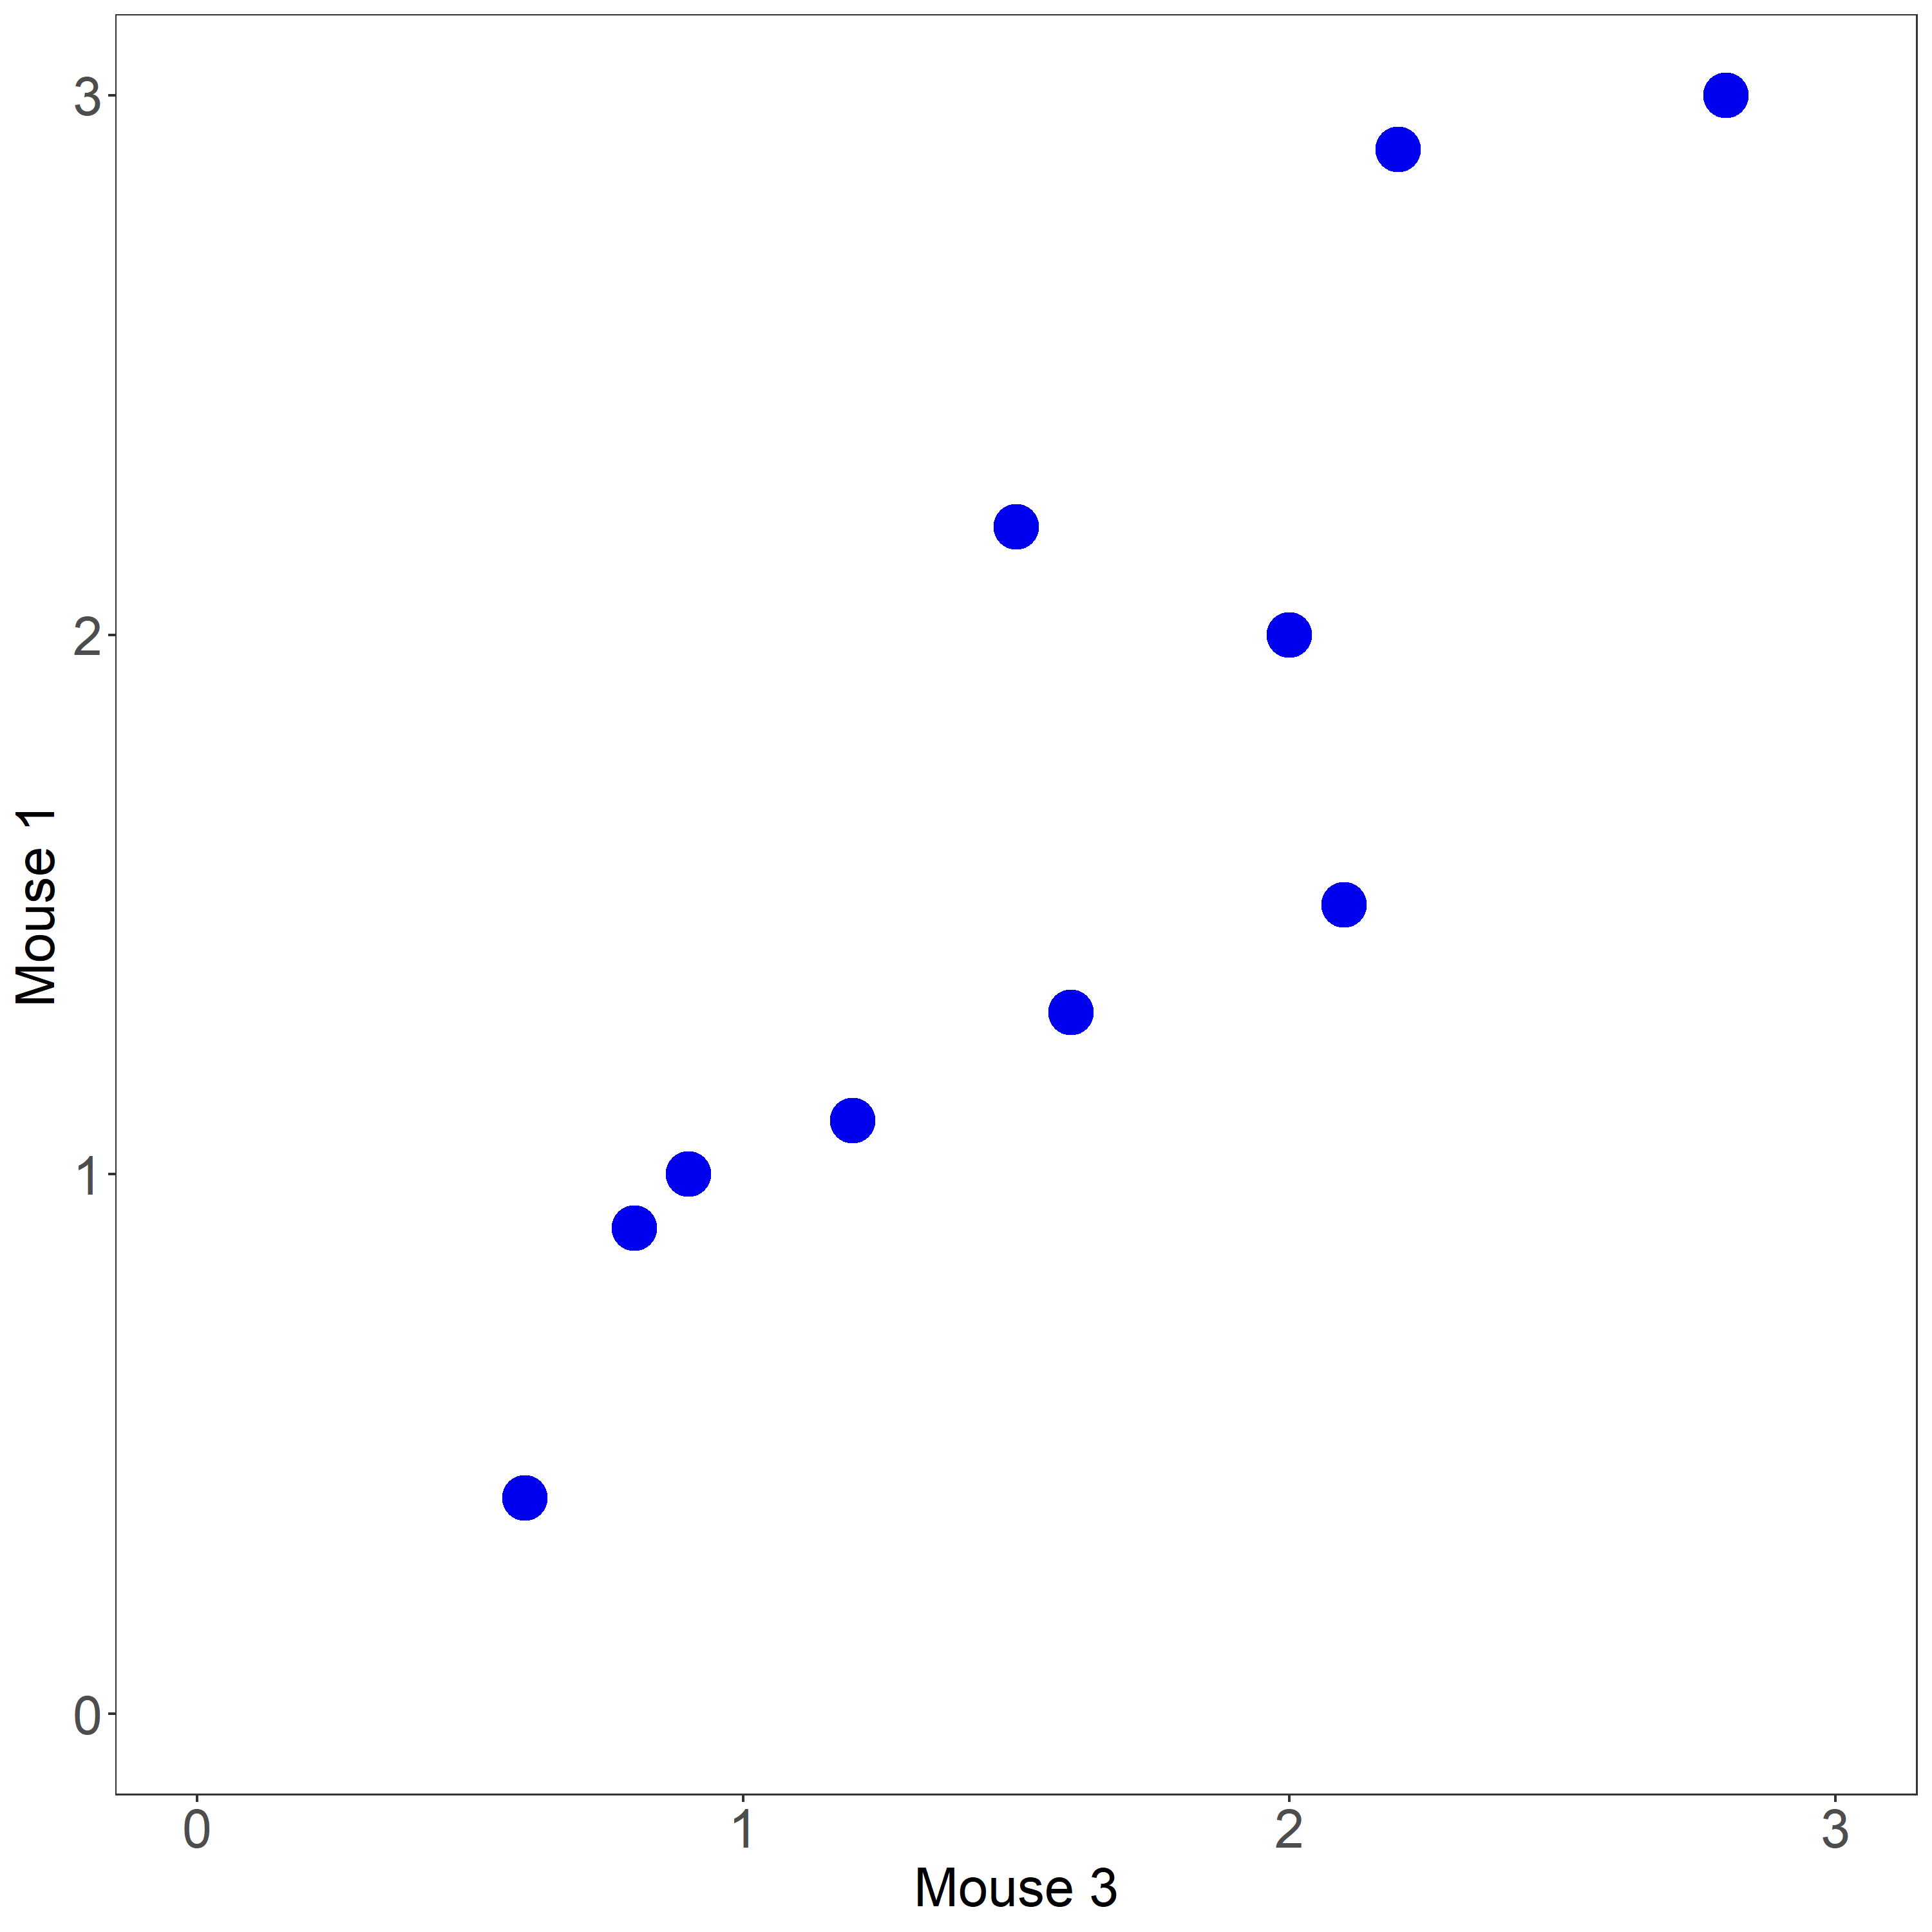
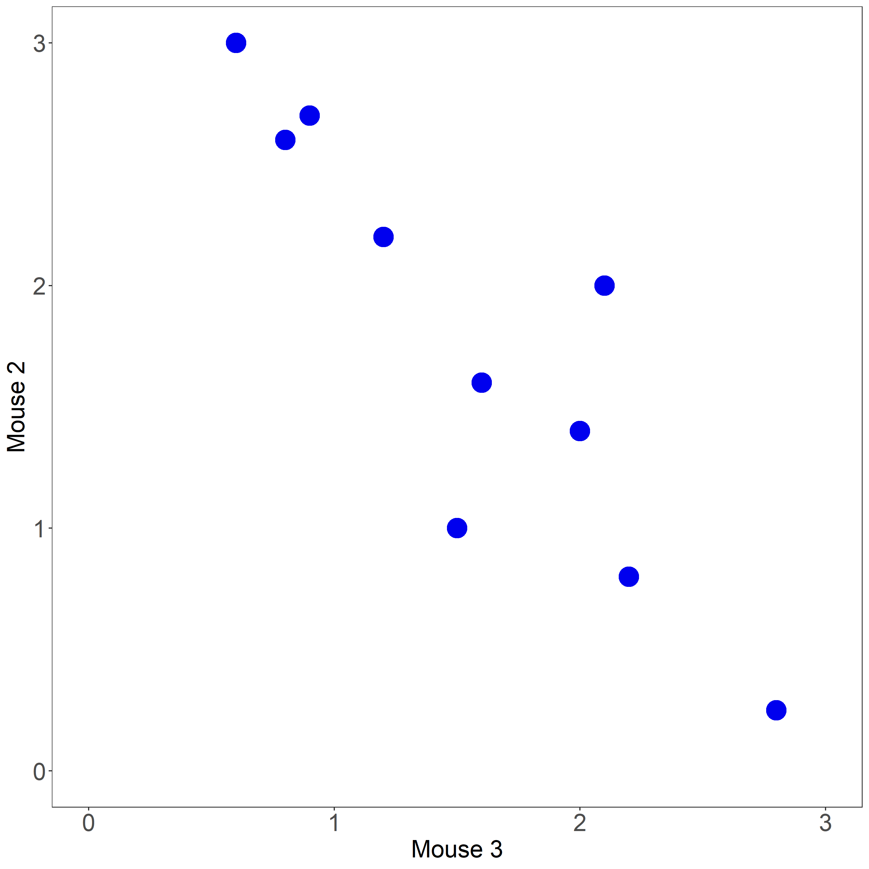
Example – 3D
 | Mouse 1 | Mouse 2 | Mouse 3
Gene 1 | 3 | 0.25 | 2.8
Gene 2 | 2.9 | 0.8 | 2.2
Gene 3 | 2.2 | 1 | 1.5
Gene 4 | 2 | 1.4 | 2
Gene 5 | 1.3 | 1.6 | 1.6
Gene 6 | 1.5 | 2 | 2.1
Gene 7 | 1.1 | 2.2 | 1.2
Gene 8 | 1 | 2.7 | 0.9
Gene 9 | 0.9 | 2.6 | 0.8
Gene 10 | 0.4 | 3 | 0.6

Slide 27
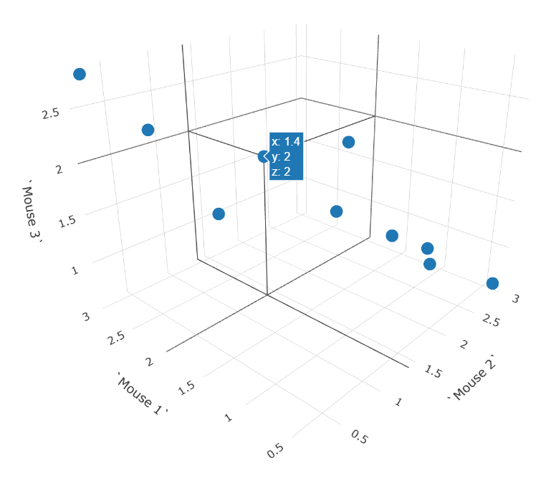
Example – 3D
 | Mouse 1 | Mouse 2 | Mouse 3
Gene 1 | 3 | 0.25 | 2.8
Gene 2 | 2.9 | 0.8 | 2.2
Gene 3 | 2.2 | 1 | 1.5
Gene 4 | 2 | 1.4 | 2
Gene 5 | 1.3 | 1.6 | 1.6
Gene 6 | 1.5 | 2 | 2.1
Gene 7 | 1.1 | 2.2 | 1.2
Gene 8 | 1 | 2.7 | 0.9
Gene 9 | 0.9 | 2.6 | 0.8
Gene 10 | 0.4 | 3 | 0.6

Slide 28
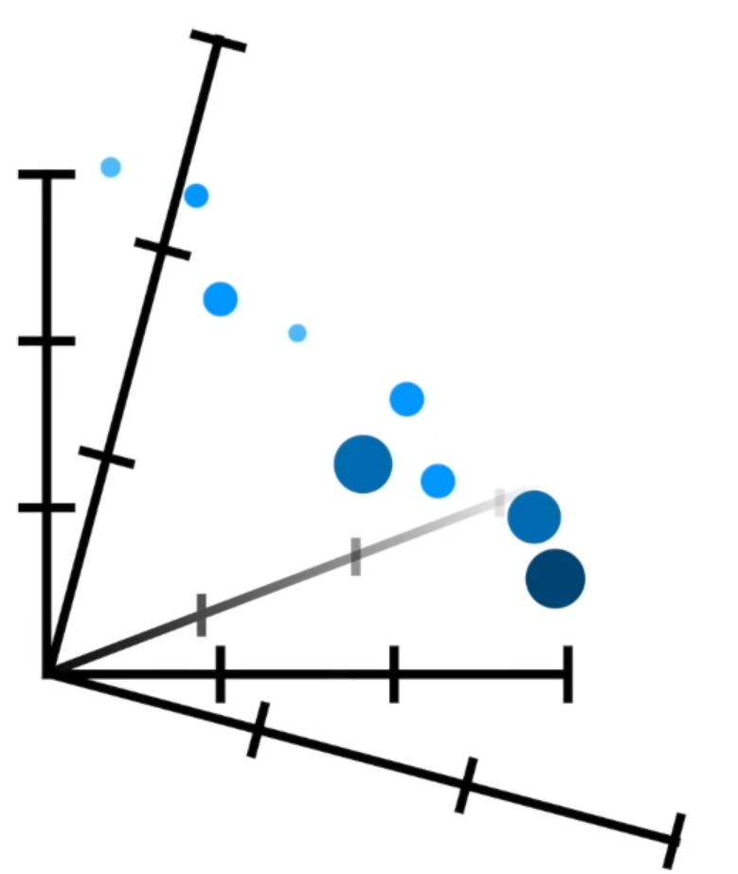
Example – nD
Mouse 4
 | Mouse 1 | Mouse 2 | Mouse 3 | Mouse 4 | ...
Gene 1 | 3 | 0.25 | 2.8 | 0.1 | ...
Gene 2 | 2.9 | 0.8 | 2.2 | 1.8 | ...
Gene 3 | 2.2 | 1 | 1.5 | 3.2 | ...
Gene 4 | 2 | 1.4 | 2 | 0.3 | ...
Gene 5 | 1.3 | 1.6 | 1.6 | 0 | ...
Gene 6 | 1.5 | 2 | 2.1 | 3 | ...
Gene 7 | 1.1 | 2.2 | 1.2 | 2.8 | ...
Gene 8 | 1 | 2.7 | 0.9 | 0.3 | ...
Gene 9 | 0.9 | 2.6 | 0.8 | 0.4 | ...
Gene 10 | 0.4 | 3 | 0.6 | 0.1 | ...
Mouse 1
Mouse 3
Mouse 2
Mouse 5

Slide 29
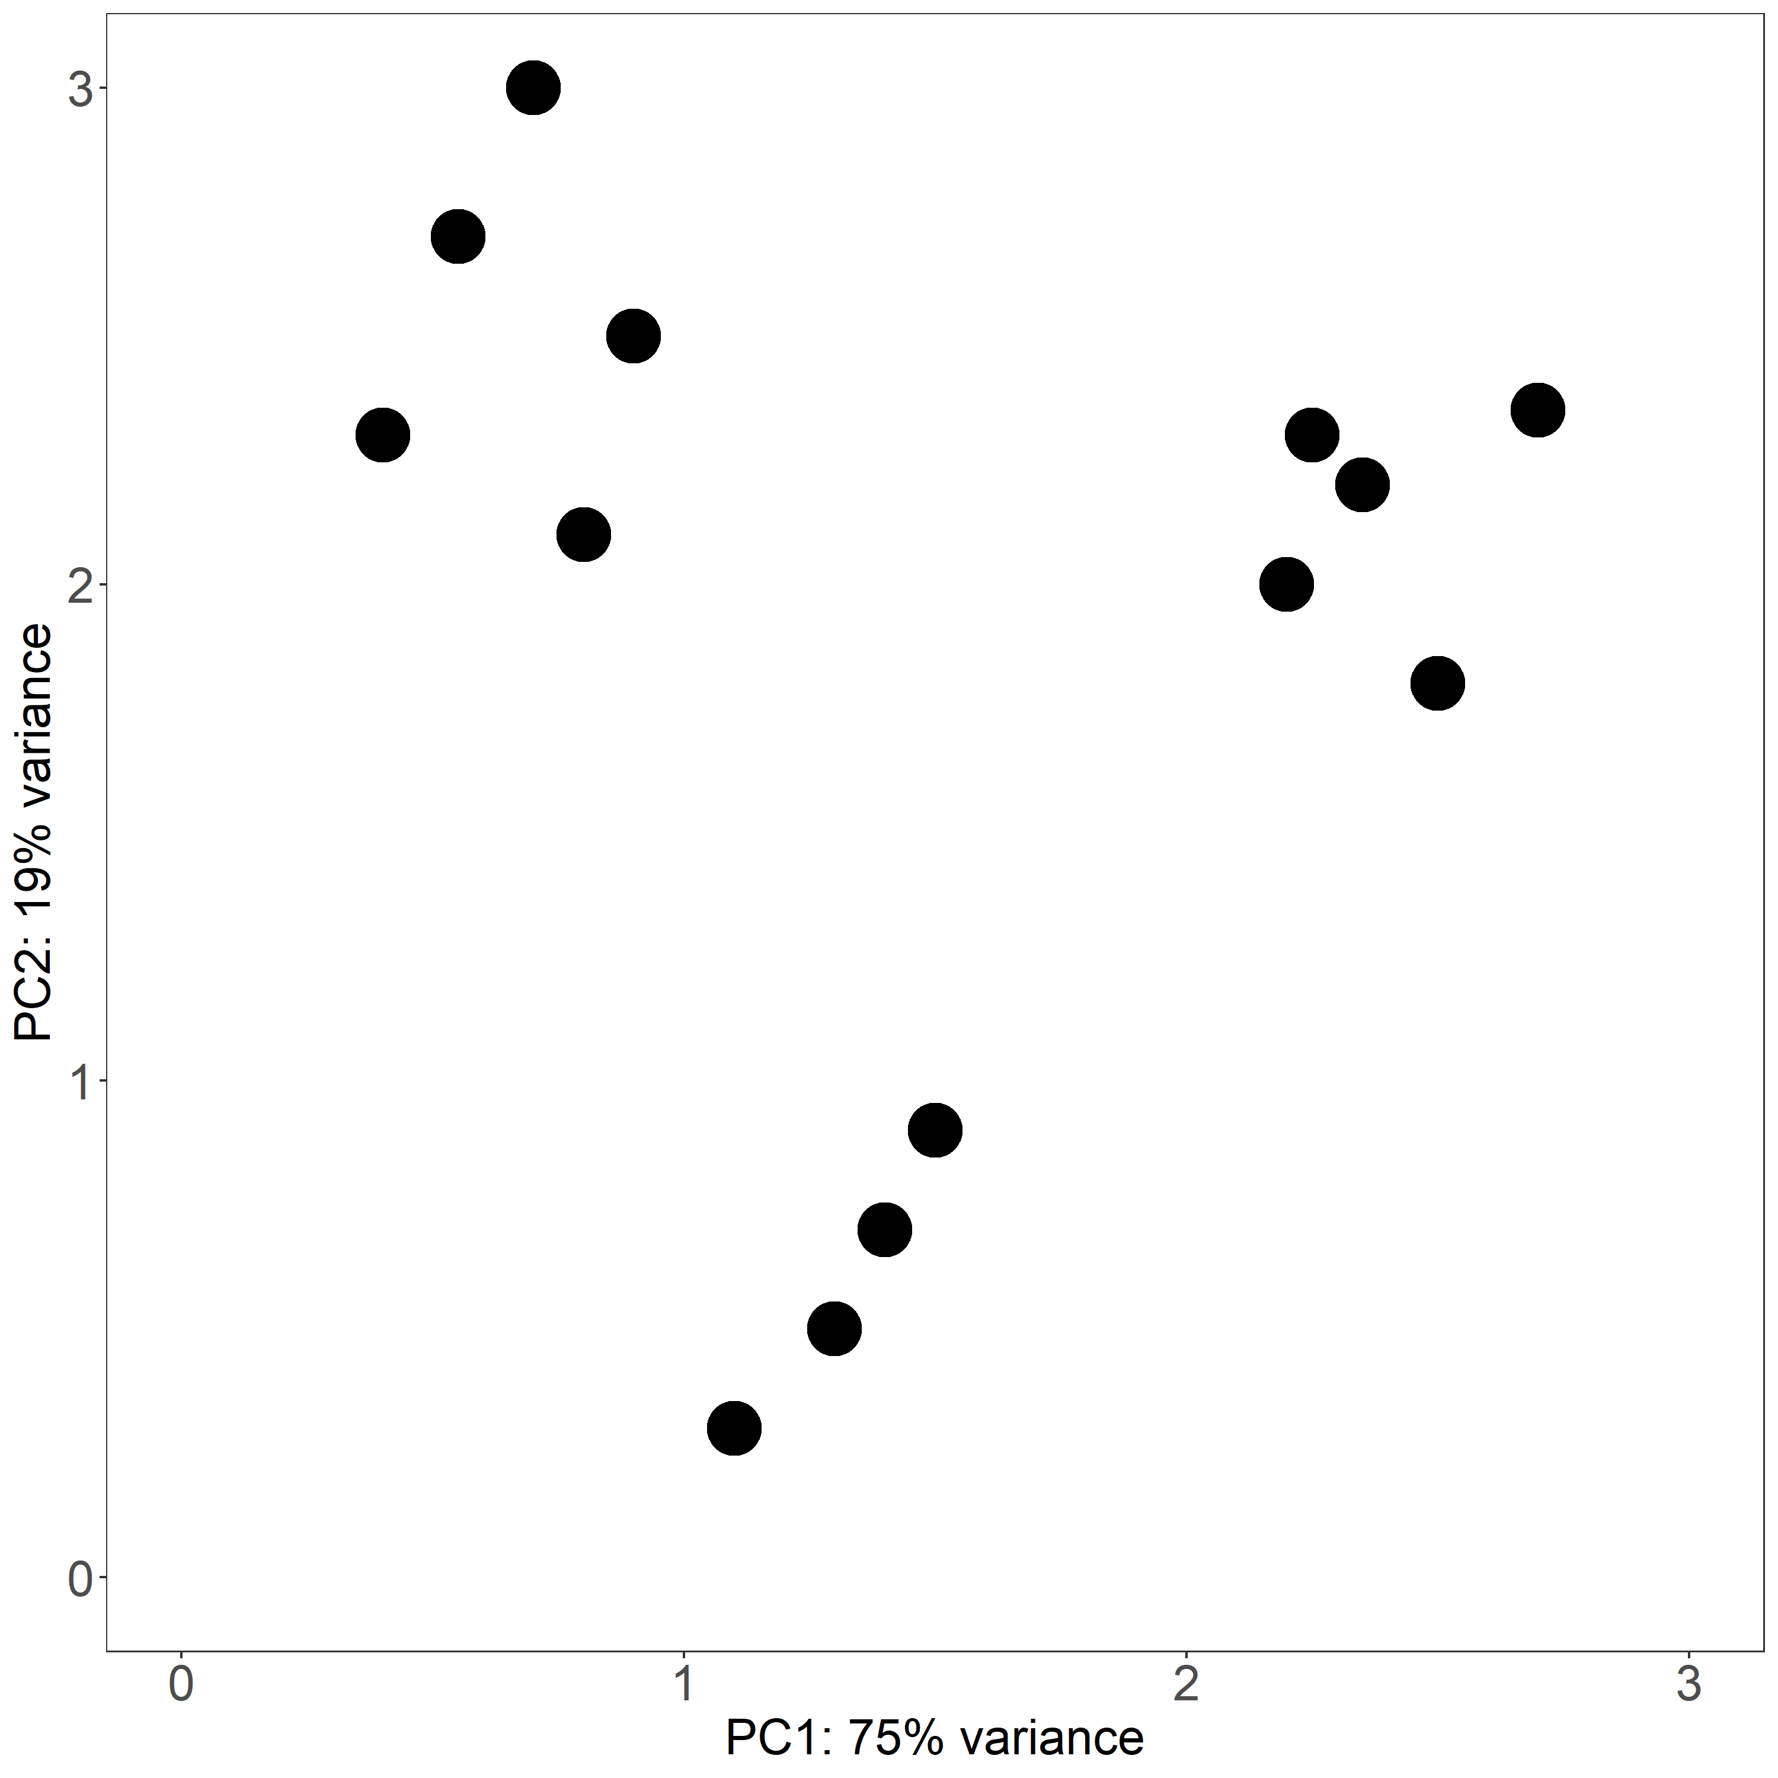
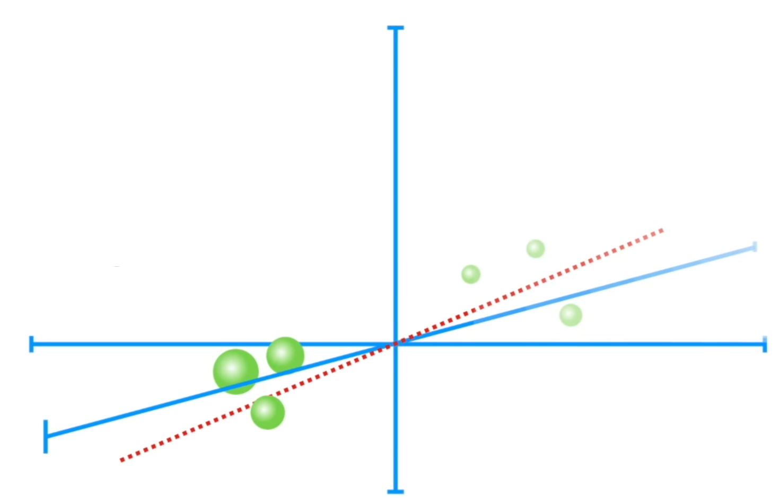
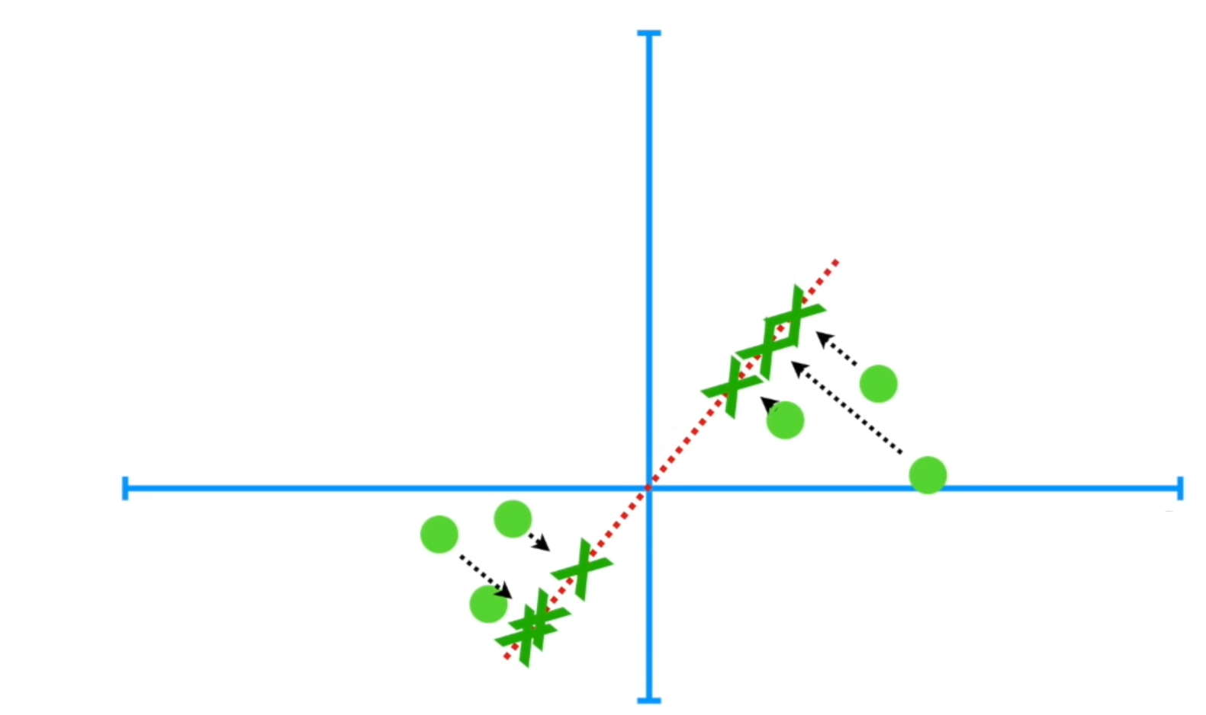
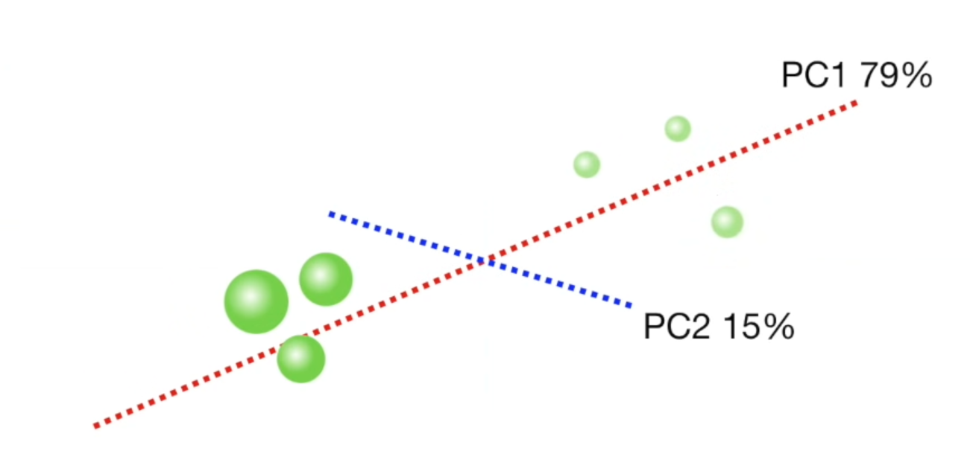
PCA
for each data point, we geometrically project it to onto lower dimensions called principal components (PCs)
goal is to find the best summary of the data while using a limited number of PCs (so we can visualize it)
the first PC is chosen to minimize the total distances between data points and their projections to PC
by minimizing this distance, we also maximize the variance of the projected points
the second (and subsequent) PCs are selected similarly, with the additional requirement that they be uncorrelated with all previous PCs.

Slide 30
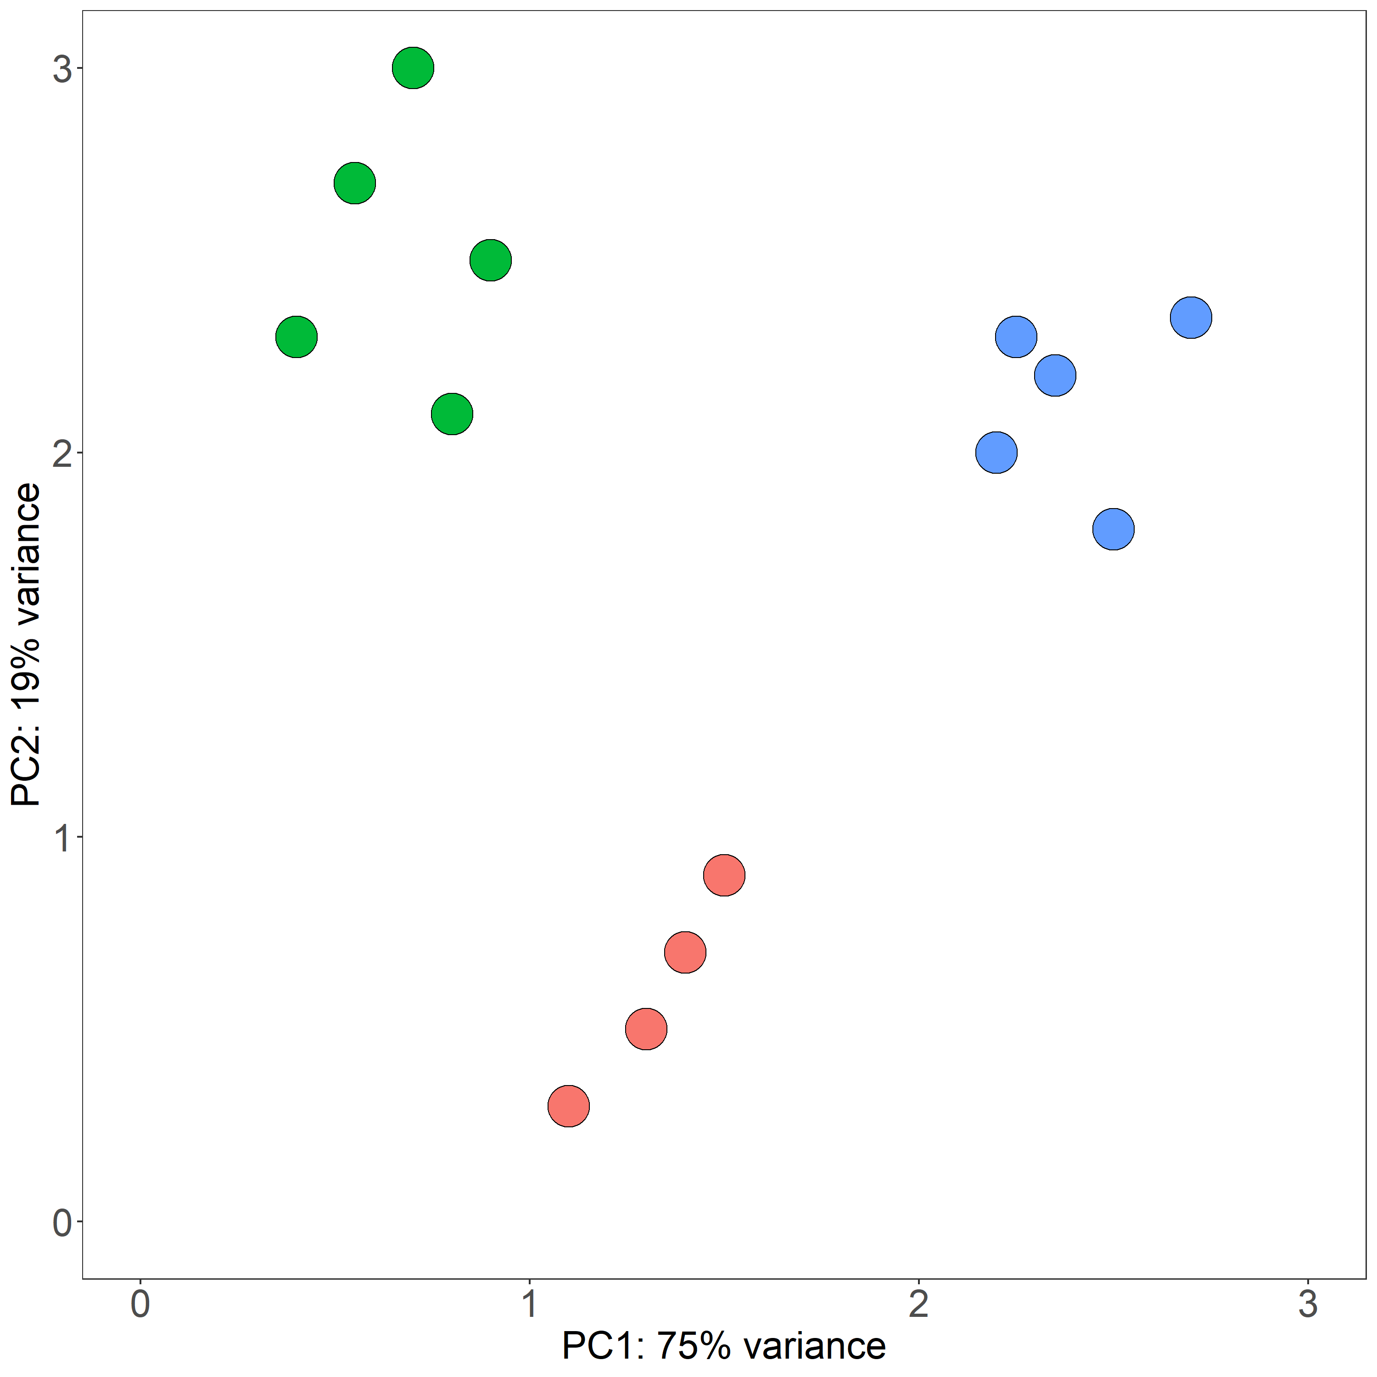
Example – PCA
 | Mouse 1 | Mouse 2 | Mouse 3 | Mouse 4 | ...
Gene 1 | 3 | 0.25 | 2.8 | 0.1 | ...
Gene 2 | 2.9 | 0.8 | 2.2 | 1.8 | ...
Gene 3 | 2.2 | 1 | 1.5 | 3.2 | ...
Gene 4 | 2 | 1.4 | 2 | 0.3 | ...
Gene 5 | 1.3 | 1.6 | 1.6 | 0 | ...
Gene 6 | 1.5 | 2 | 2.1 | 3 | ...
Gene 7 | 1.1 | 2.2 | 1.2 | 2.8 | ...
Gene 8 | 1 | 2.7 | 0.9 | 0.3 | ...
Gene 9 | 0.9 | 2.6 | 0.8 | 0.4 | ...
Gene 10 | 0.4 | 3 | 0.6 | 0.1 | ...

Slide 31
PCA take home messages – RNA-seq
starting data
counts of reads over annotated genes
each row = one gene
each column = one sample
PCA is a method for compressing high-dimensional data into low-dimensional data with the goal of finding the best summary of starting data
each dot on a plot represents transcriptional profile of ~10000 transcribed genes in one sample
samples with similar transcriptional profiles will be grouped together
axes are ranked in order of importance

Slide 32
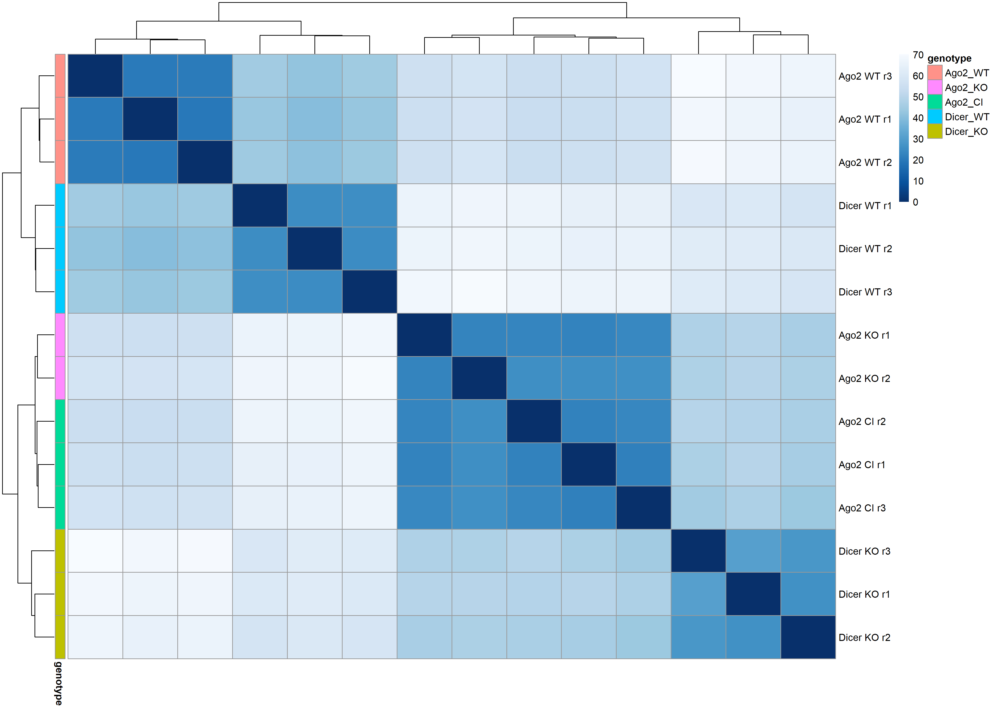
Distance between samples
overview over how similar are samples to each other
samples are hierarchically clustered based on the sample distances (by default Euclidean distances)

Slide 33
DESeq2 function
normalizes counts
tests for differential expression based on a model using the negative binomial distribution
how it works:
read counts are first scaled by a normalization factor to account for differences in sequencing depth between samples
dispersion (the variability between replicates) is calculated for each gene
negative binomial generalized linear model (GLM) is fitted for each gene using those estimates and normalized counts
GLM fit returns coefficients indicating the overall expression strength of the gene and coefficients (i.e., log₂-fold change) between treatment and control (in our analysis knock-out and wild type samples)
significance of coefficients in GLMs are tested with the Wald test
obtained p-values are adjusted for multiple testing using the Benjamini and Hochberg False Discovery Rate procedure

Slide 34
Replicates, replicates and more replicates
replicates are crucial for meaningful and statistically valid analysis
algorithm compares variance of expression of each gene within the replicates with variance between the samples
gene expression can vary in response to many factors (for example temperature, time of day, stress...)
goal of the analysis is to find variability in expression due to our controlled treatment or condition and not due to other uncontrollable factors
this is only possible if you have enough replicates to discriminate between real signal and noise
at least three biological replicates per condition are necessary for meaningful DE analysis
more replicates give you more statistical power and sensitivity

Slide 35
DESeq2 function – results
baseMean – an average of the normalized count values across all samples
log2FoldChange – the effect size estimate which tells us how much the gene’s expression seems to have changed in KO in comparison to the WT samples
lfcSE – the standard error estimate for the log2 fold change estimate (uncertainty associated with log2FC estimate)
pvalue – indicates the probability that a fold change as strong as the observed one, or even stronger, would be seen under the situation described by the null hypothesis
null hypothesis = there is zero effect of the KO on the gene and the observed difference between KO and WT was caused by experimental variability
padj – p-value adjusted for multiple testing

Slide 36
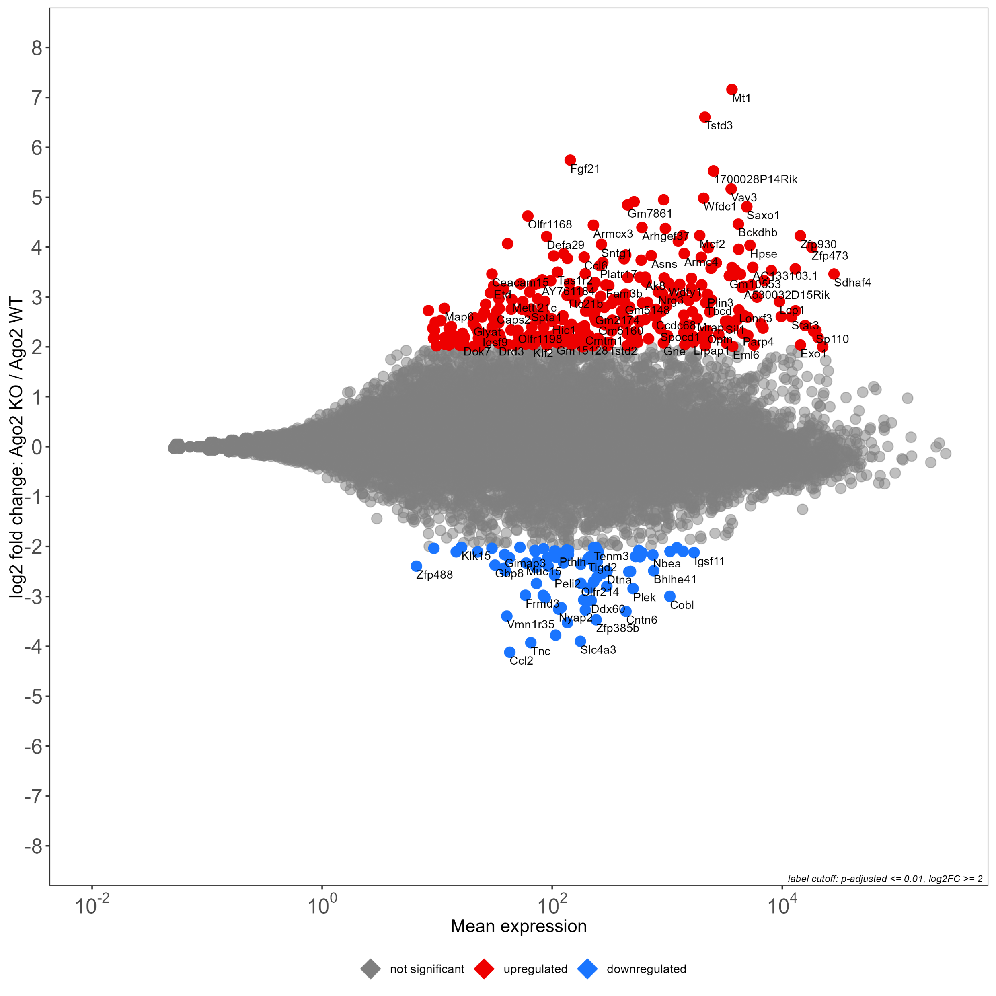
MA plot
an MA-plot provides a useful overview for the distribution of the estimated coefficients in the model across all genes
on the y-axis, the M stands for minus = log2 fold change for a particular comparison (subtraction of log values is equivalent to the log of the ratio)
on the x-axis, the A stands for average = average of the counts normalized by size factor

Slide 37
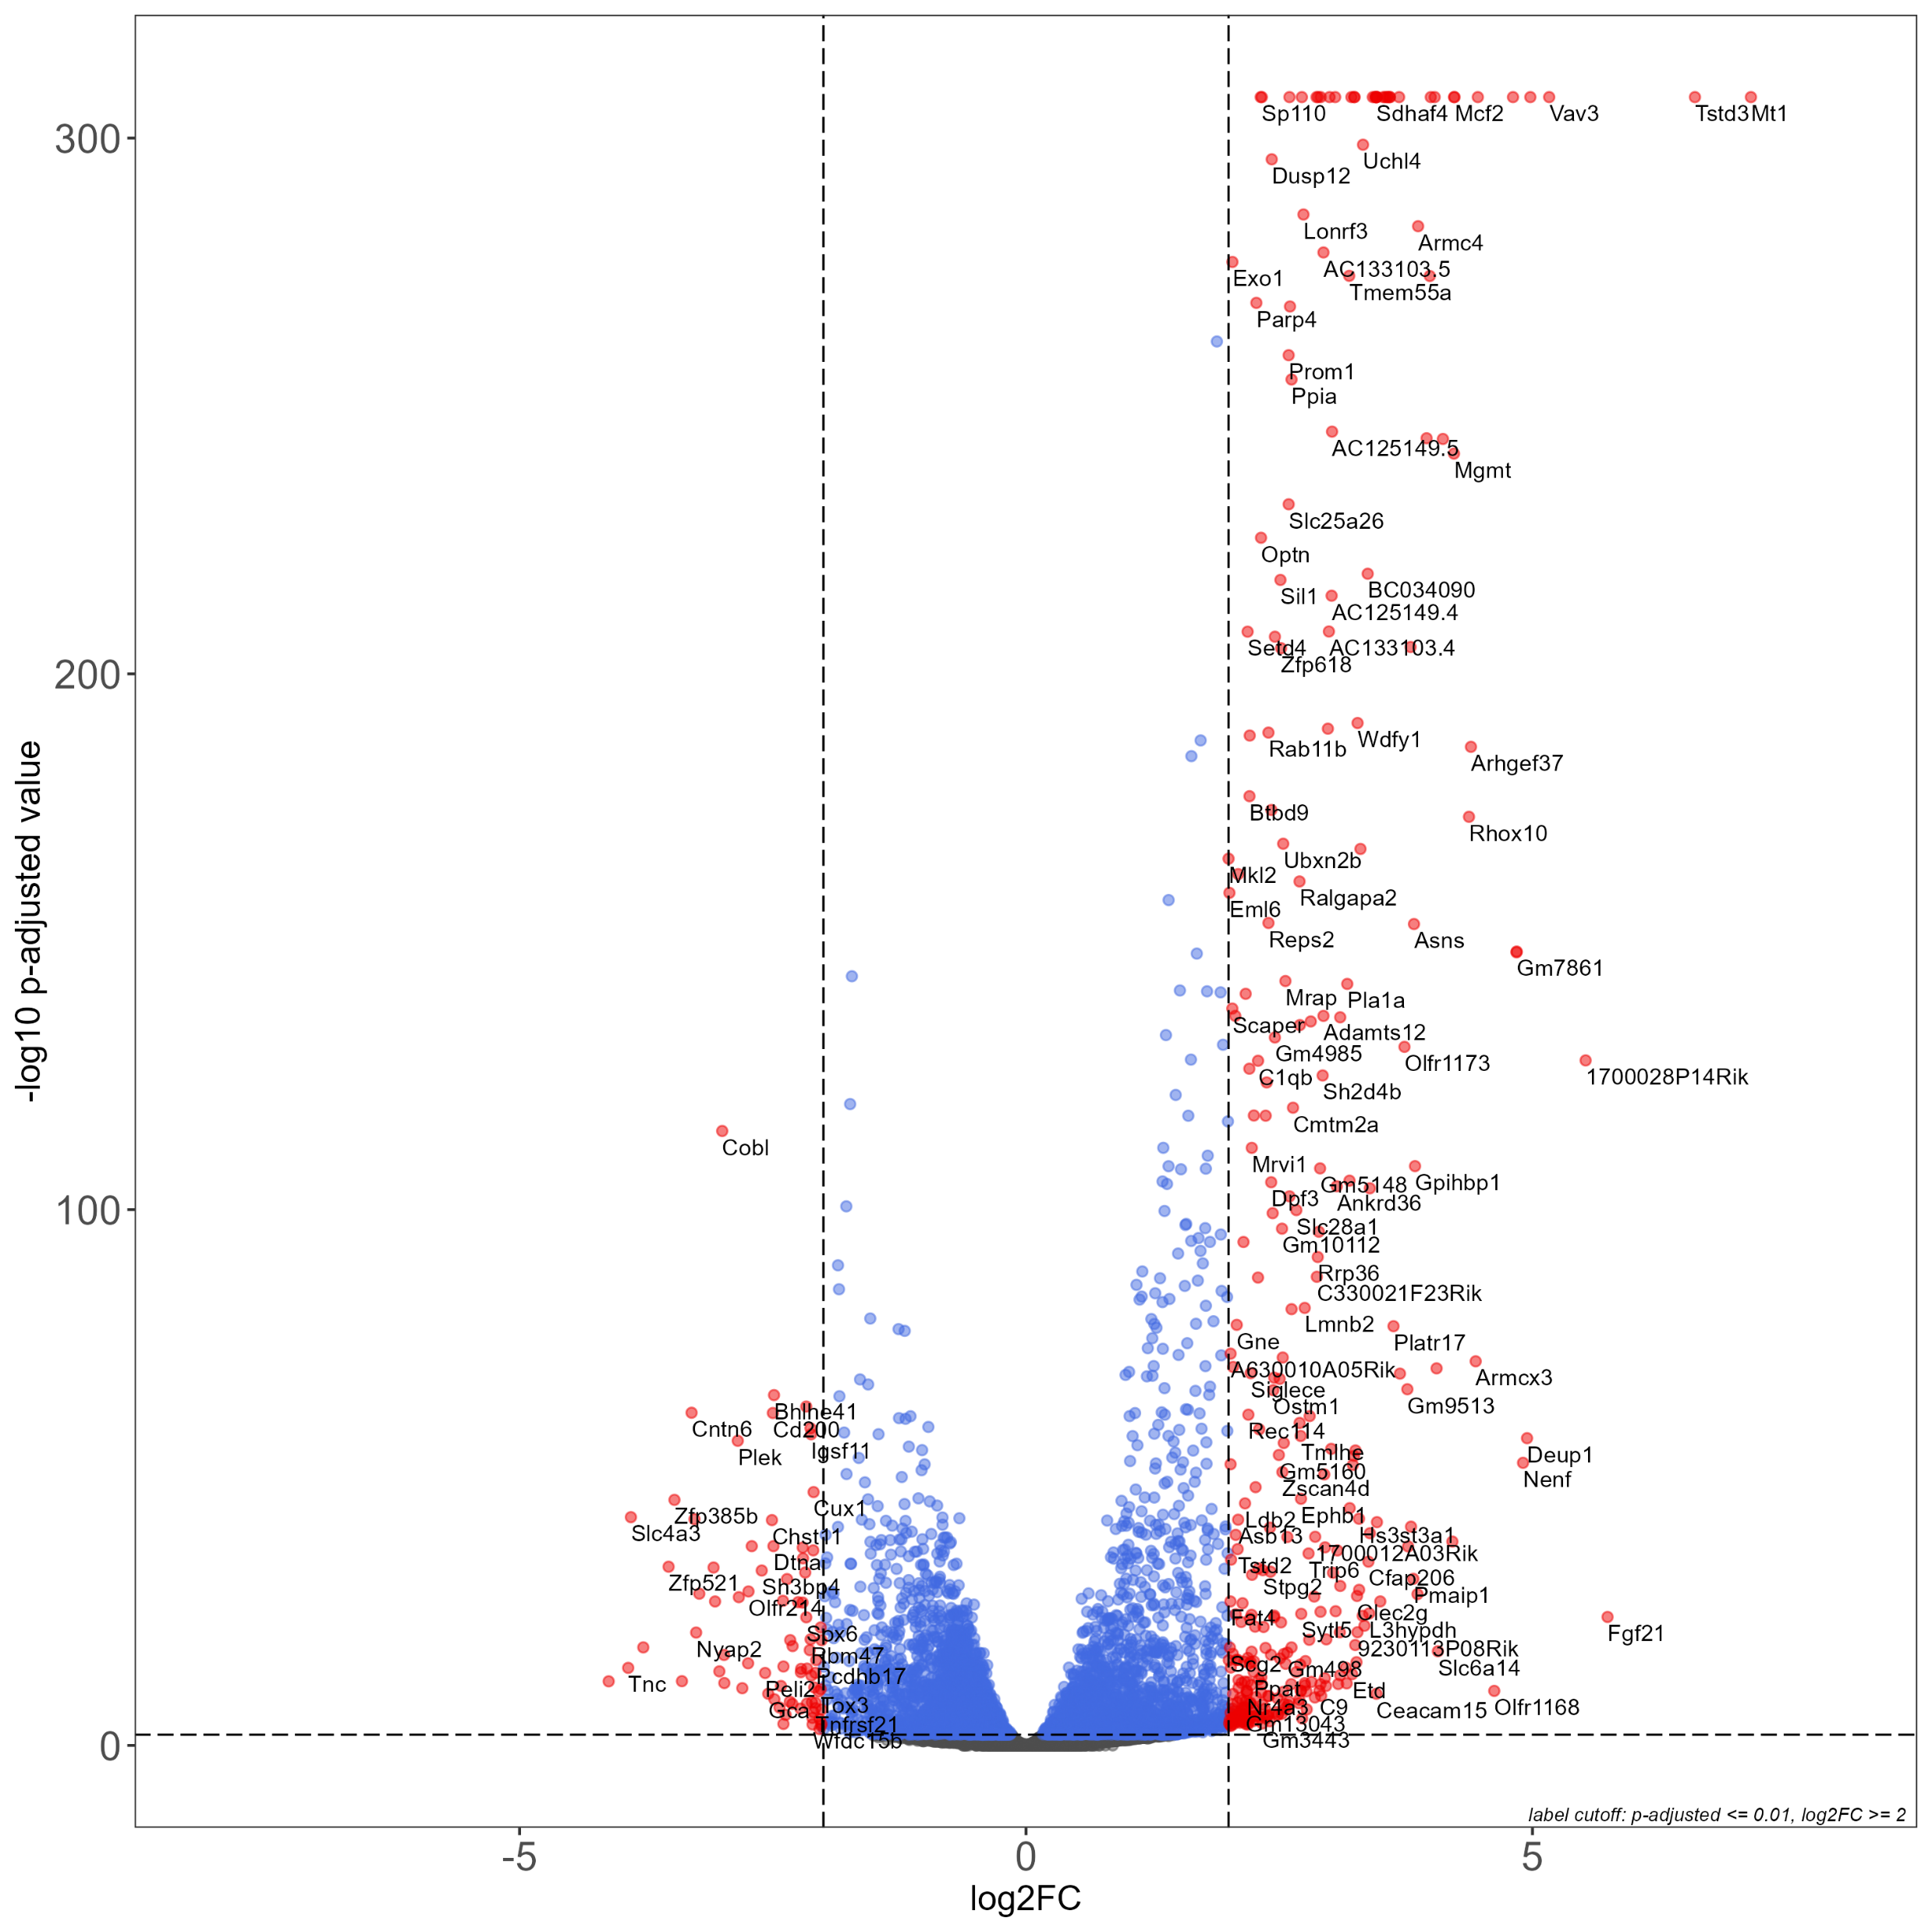
Volcano plot
shows statistical significance (P value) versus magnitude of change (fold change)
enables visual identification of genes with large fold changes that are also statistically significant

Slide 38
Gene list functional enrichment
enrichment analysis on gene sets
it finds terms that are over-represented in a list of upregulated/downregulated genes under certain condition
Gene Ontology terms
biological pathways
regulatory DNA elements
human disease gene annotations
protein-protein interaction networks
specifically, uses these databases: GO:MF, GO:CC, GO:BP, KEGG, REAC, TF, MIRNA, CORUM, HP, WP
also available at a webpage: https://biit.cs.ut.ee/gprofiler/gost

Slide 39
More resources
.fastq format: https://support.illumina.com/bulletins/2016/04/fastq-files-explained.html
.sam/.bam format: http://samtools.github.io/hts-specs/
RNA-seq analysis in Galaxy tutorial: https://training.galaxyproject.org/training-material/topics/transcriptomics/tutorials/ref-based/tutorial.html
DESeq2: http://bioconductor.org/packages/devel/bioc/vignettes/DESeq2/inst/doc/DESeq2.html
Computational Genomics with R, Altuna Akalin: https://compgenomr.github.io/book/
PCA: Lever, J., Krzywinski, M. & Altman, N. Principal component analysis. Nat Methods 14, 641–642 (2017). https://doi.org/10.1038/nmeth.4346

